Slide 1
Machine Learning Basics
Machine Learning with Python

Slide 2
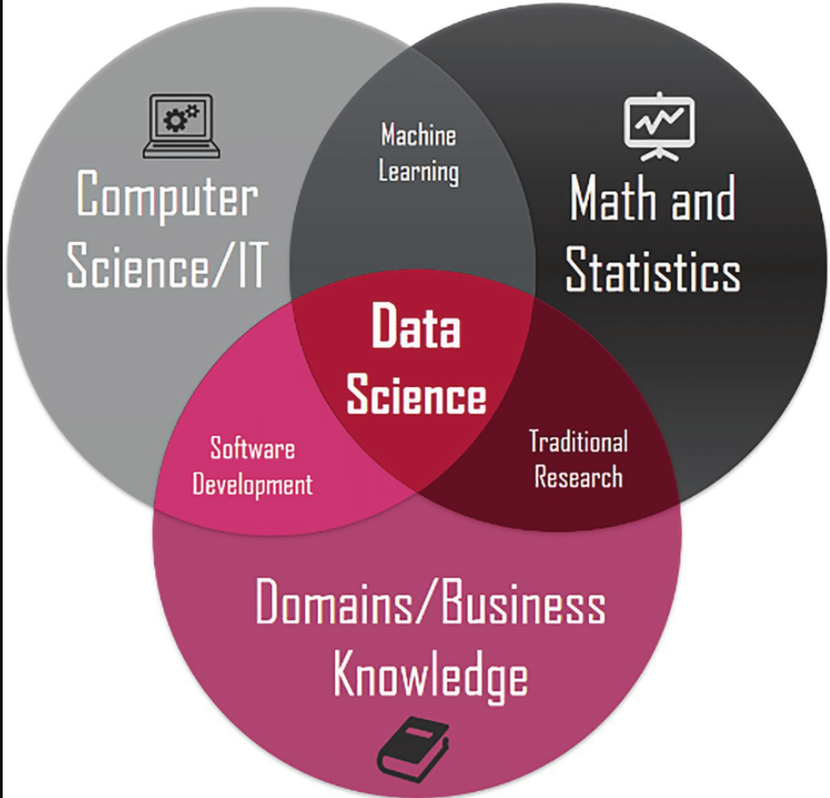

Slide 3
Machine Learning (ML) Intro
study and design of software algorithms that are capable of learning on their own
without explicit human / developer programming or intervention.
These algorithms can learn to optimize performance in a specific task
for e.g. making accurate predictions about future outcomes based on historical data from the past

Slide 4
Machine Learning Intro
Machine learning is a subfield of artificial intelligence
involves development of algorithms based on statistical models
closely related to data mining and Data Science

Slide 5
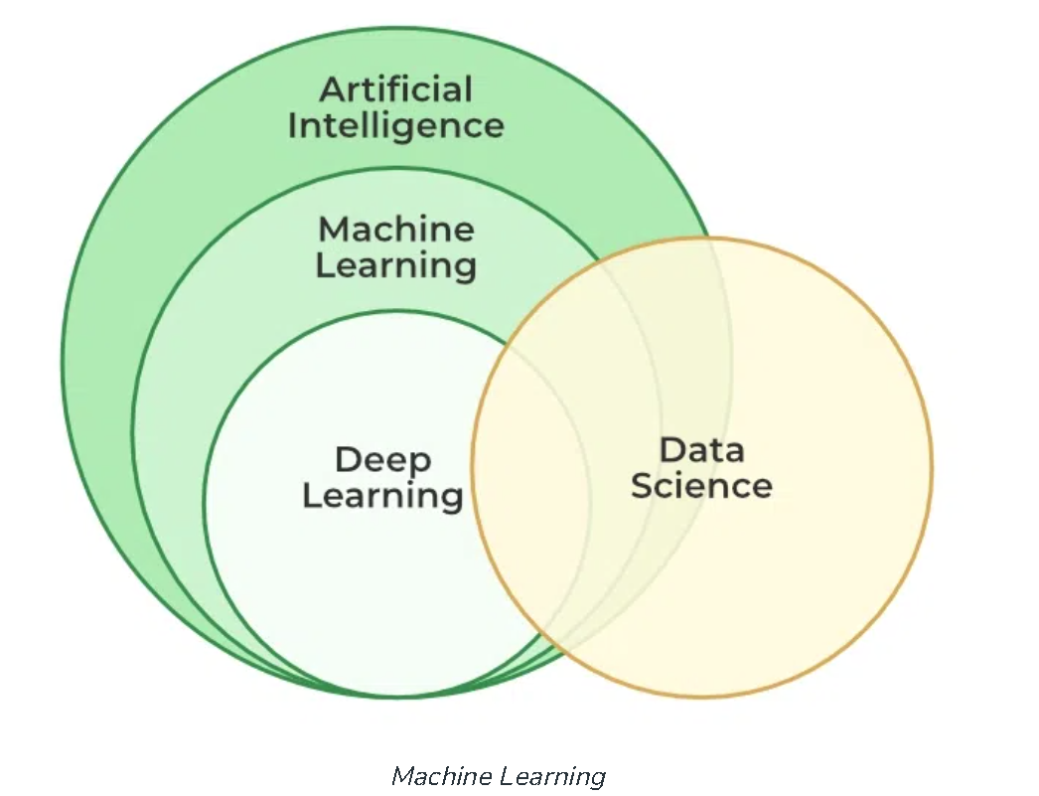

Slide 6
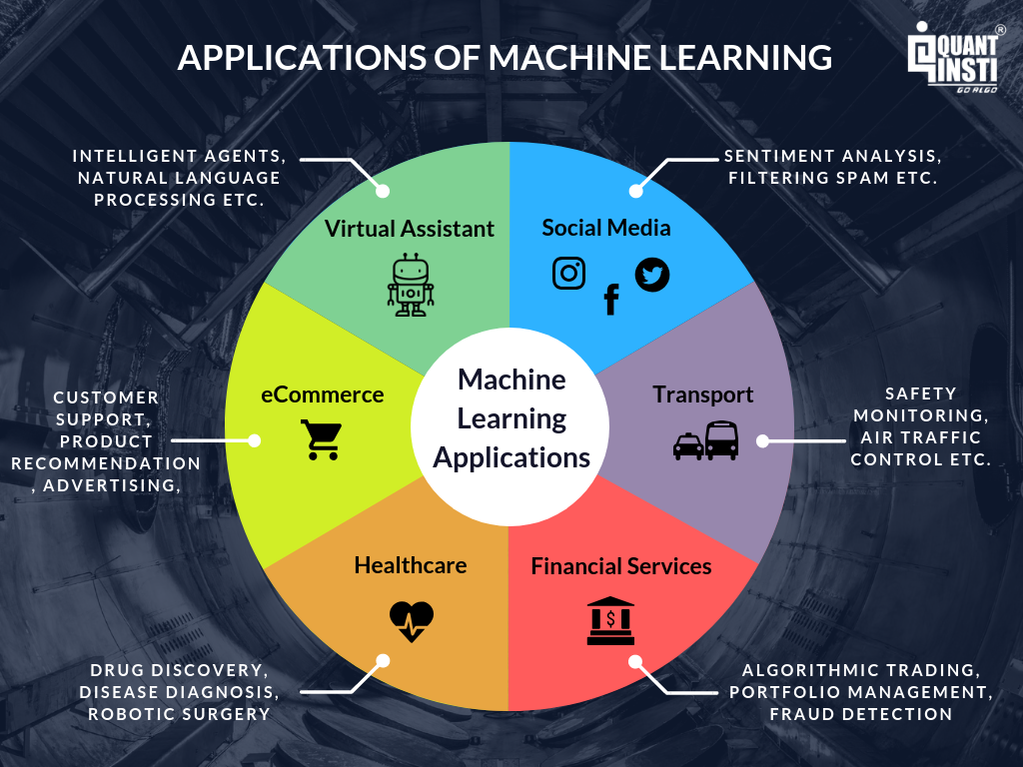

Slide 7
ML algorithms and models
Models are key to ML
Internal mathematical representation of patterns within existing data
Models are created by a ML algo
Different algos create different models with different characteristics

Slide 8
Supervised Learning
ML model is trained on a labelled data set
This contains input / independent / feature variables and one output / dependent / target variable (the label)
The feature variables are the attributes or properties of the data set that influence the dependent / target variables
ML model learns the best target function (f)
that maps feature variables (X) to an target variable (Y)

Slide 9
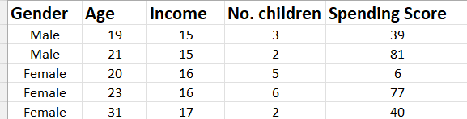
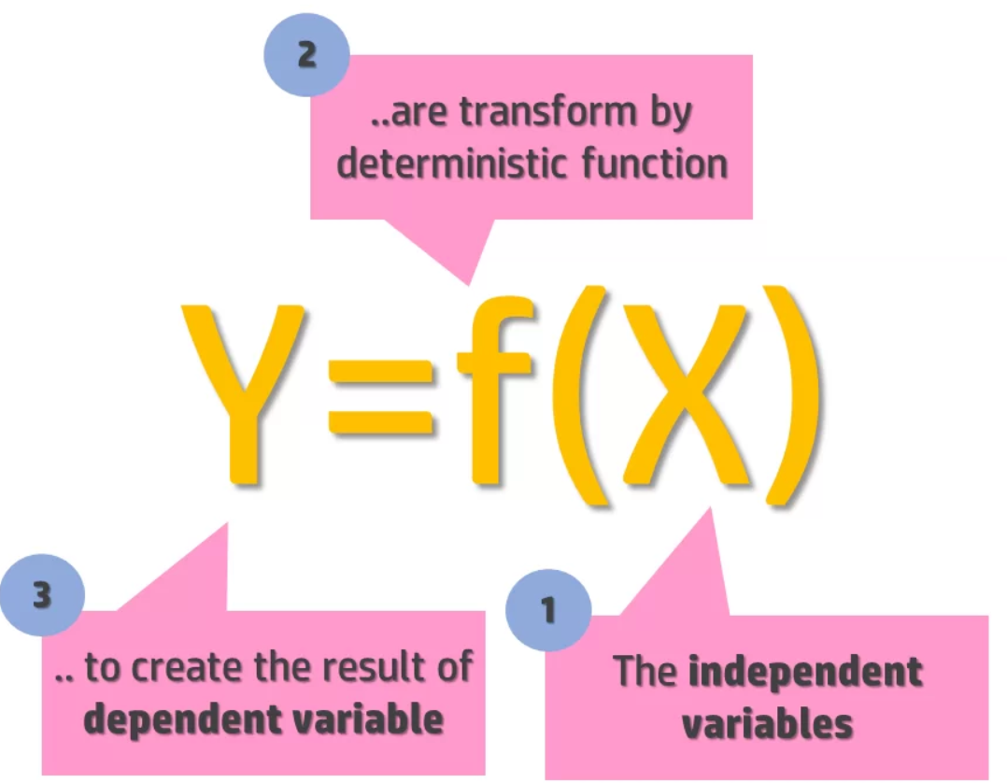
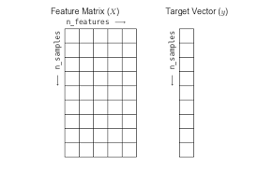
Input / independent / feature variables
Output / dependent / target variable (label)
Observations /
Samples / Datapoints

Slide 10
Supervised Learning
The target variable provides context for training the ML model
Algorithm learns to identify and model a specific relationship between the features and target variable
The training process is termed fitting the model
The trained / fitted model can then make a reasonably accurate prediction of target values corresponding to new features that it has yet to encounter
More commonly known as predictive modeling / analytics

Slide 11
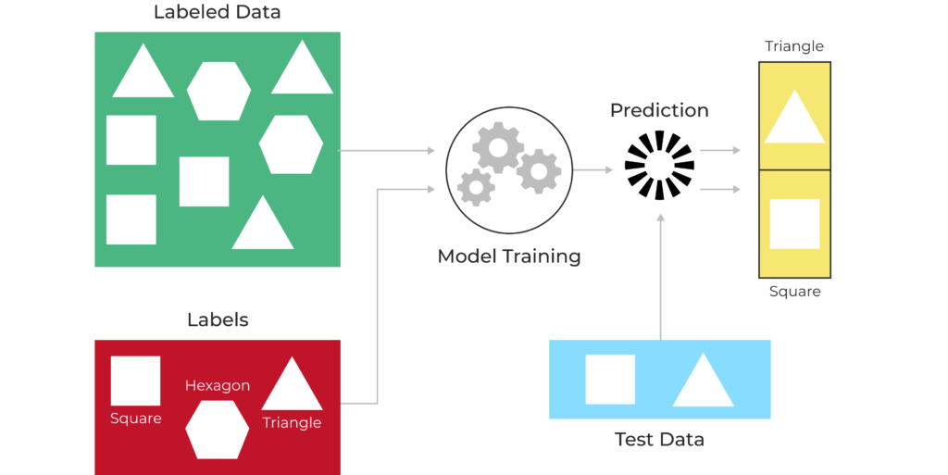
Supervised learning

Slide 12
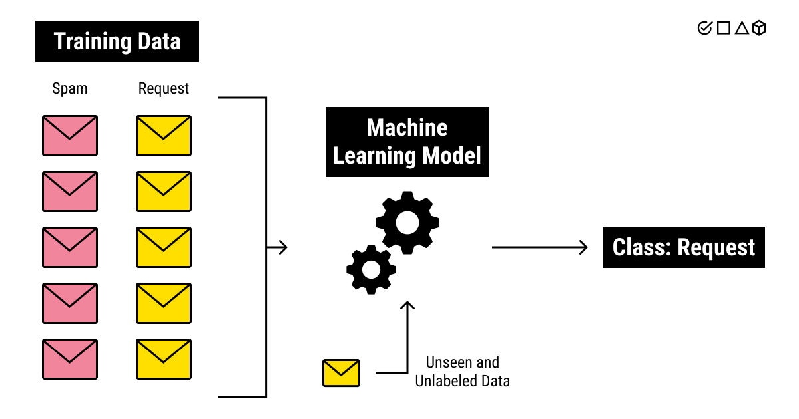
Supervised learning

Slide 13
Supervised learning
During the training process
ML model iteratively predicts the target variable from the features of each observation / datapoint in the original dataset
gradually improves its response
By minimizing its error function by processing increasing amounts of labelled data points in the dataset

Slide 14
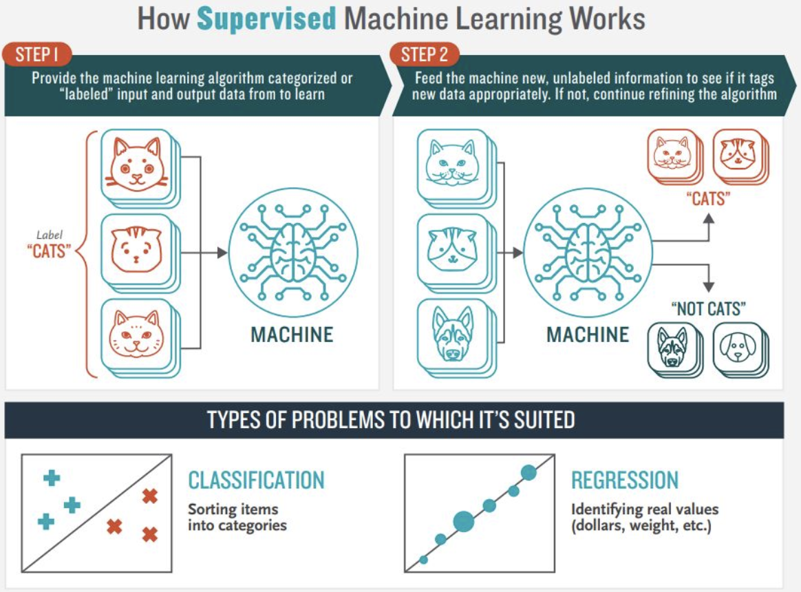

Slide 15
Areas of supervised learning
Regression
used to predict a continuous target variable, such as price of a house or salary of an employee
Classification
used to predict a categorical target variable (or class label) which has discrete values
e.g. whether a customer will buy a house or not, default on a loan or not, etc.
Binary classification - For simple cases where the values are true or false
Multiclass classification - when there are more than two classes or types of values

Slide 16
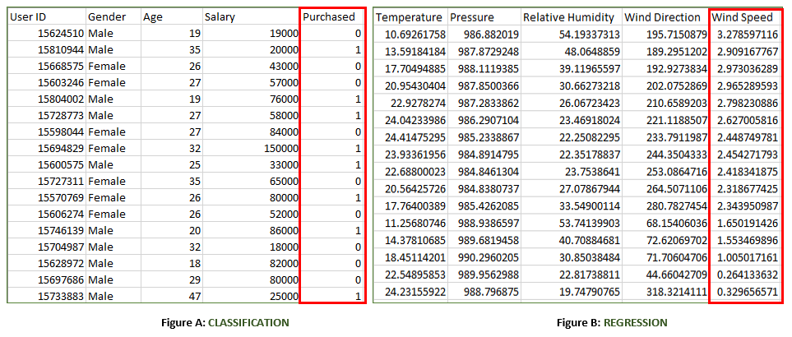
Classification vs regression

Slide 17
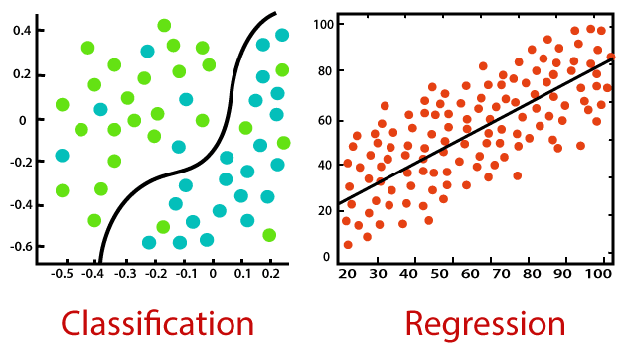
Classification vs regression

Slide 18
Machine learning operation
Forward Pass
ML algo takes input data (feature variables) and computes predictions from them based on its learning function
Loss Function / Error / Cost function
used to evaluate the accuracy of the predictions made by the model
compares the predicted output of the model to the actual output (target variable / labels) and calculates the difference between them (error / loss)
The goal of the algo is to minimize the error or loss function by adjusting its internal parameters / weights

Slide 19
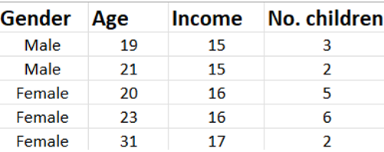
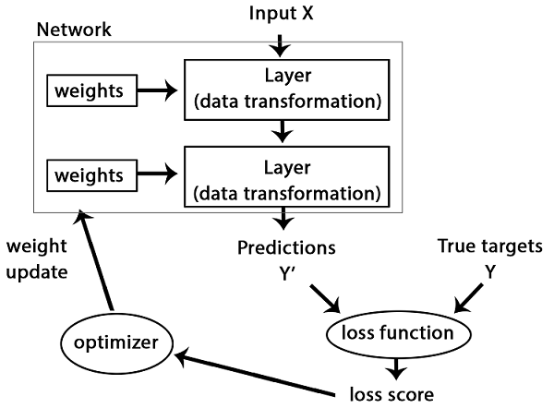
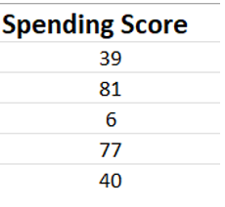
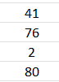
ML internal operation for supervised learning
Input / independent / feature variables
Output / dependent / target variable (label)

Slide 20
Machine learning operation
Model Optimization
iterative process of adjusting the internal parameters of the model to minimize the error or loss function to a satisfactory level
Typically achieved via an optimization algorithm, popular example is gradient descent
Error can NEVER be eliminated, only minimized
This is irreducible error
This means models are always only an APPROXIMATION of the true patterns in the dataset

Slide 21
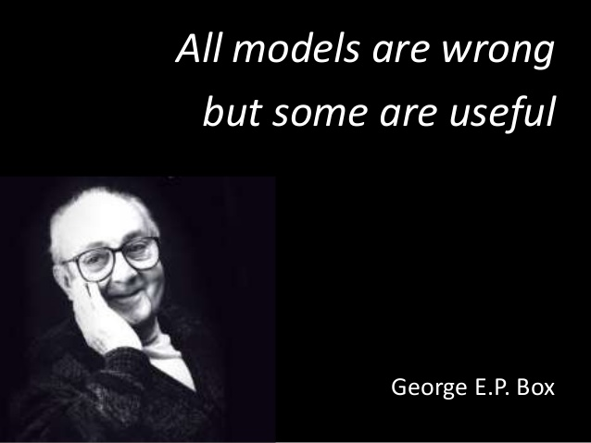

Slide 22
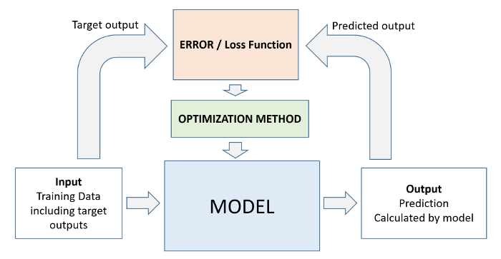
How machine learning works

Slide 23
Unsupervised Learning
ML model works on its own
discover previously undetected patterns or groupings within a dataset on its own
Input dataset to this model consists only of feature variables without a corresponding target variables (i.e. an unlabeled dataset)
typically applied to build a meaningful summary / representation of the unlabeled dataset
so humans can derive useful insights from it

Slide 24

Input / independent / feature variables
NO target variable (the label)
Observations /
Samples / Datapoints

Slide 25
Clustering
grouping observations in the dataset based on their similarities / differences
When two instances appear in same / different groups, we can infer they have similar / dissimilar properties
There many different types of clustering
Exclusive, Overlapping, Hierarchical and Probabilistic

Slide 26
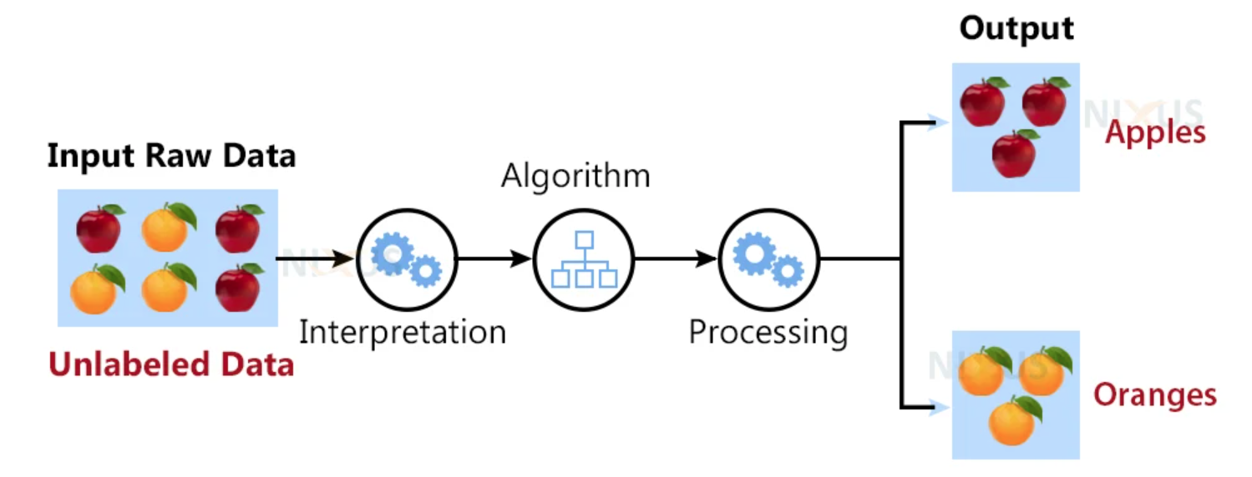
Clustering

Slide 27

Clustering

Slide 28
Association rules
takes a rule-based approach to discovering interesting relationships between features in a given dataset
works by using a measure of interest to identify strong rules found within a dataset
typically used for market basket analysis

Slide 29
Dimensionality Reduction
used when the number of features, or dimensions, in a given dataset is too high
seek to transform data from high-dimensional spaces (many features) to low-dimensional spaces (low number of features)
while at the same time maintaining the integrity or meaningful properties in the original data
These techniques are typically deployed during exploratory data analysis (EDA) or data preprocessing to prepare the data for modeling

Slide 30
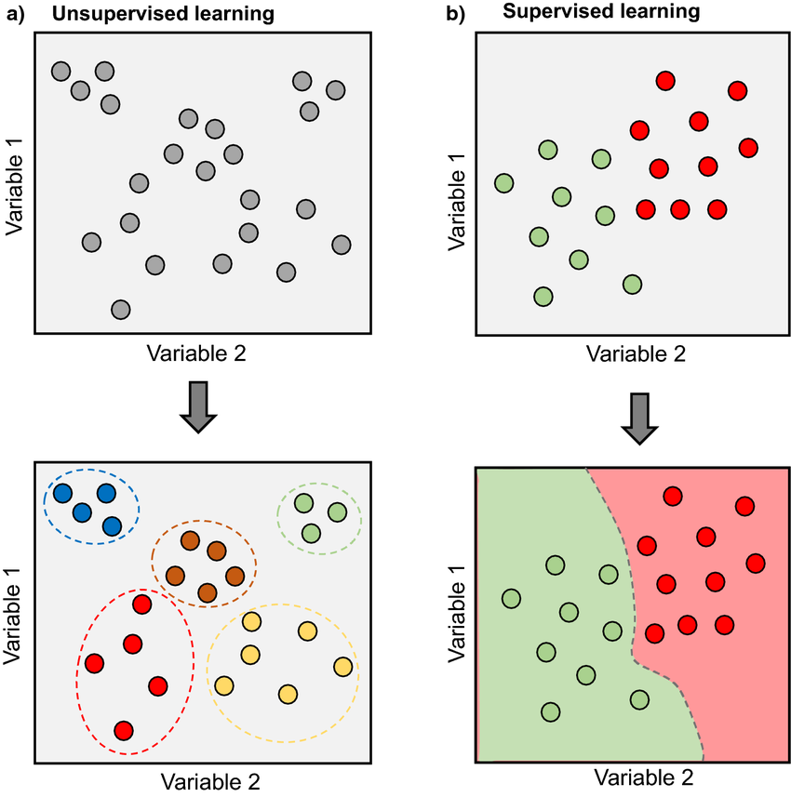
Supervised vs unsupervised

Slide 31
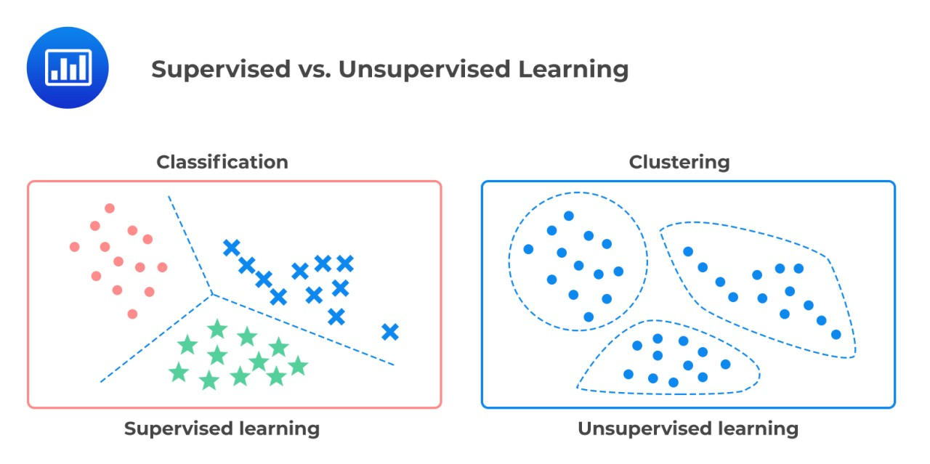
Supervised vs unsupervised

Slide 32
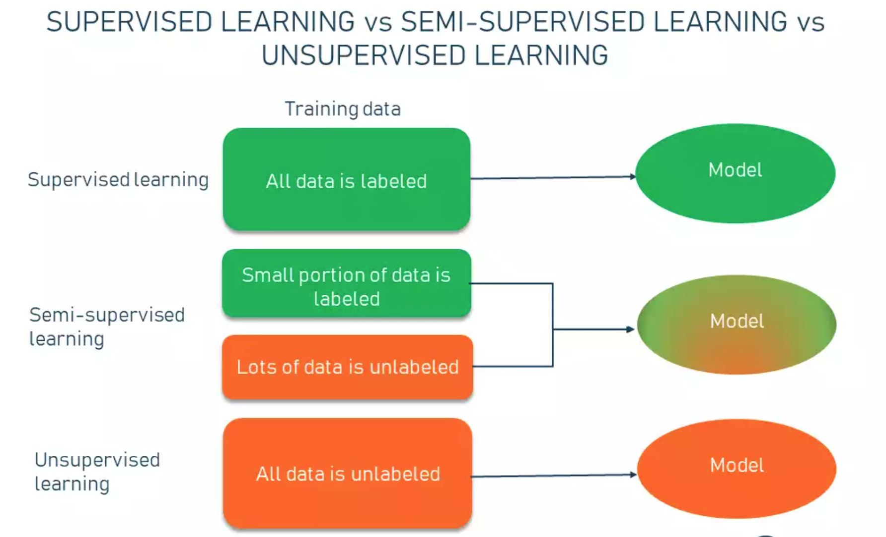

Slide 33
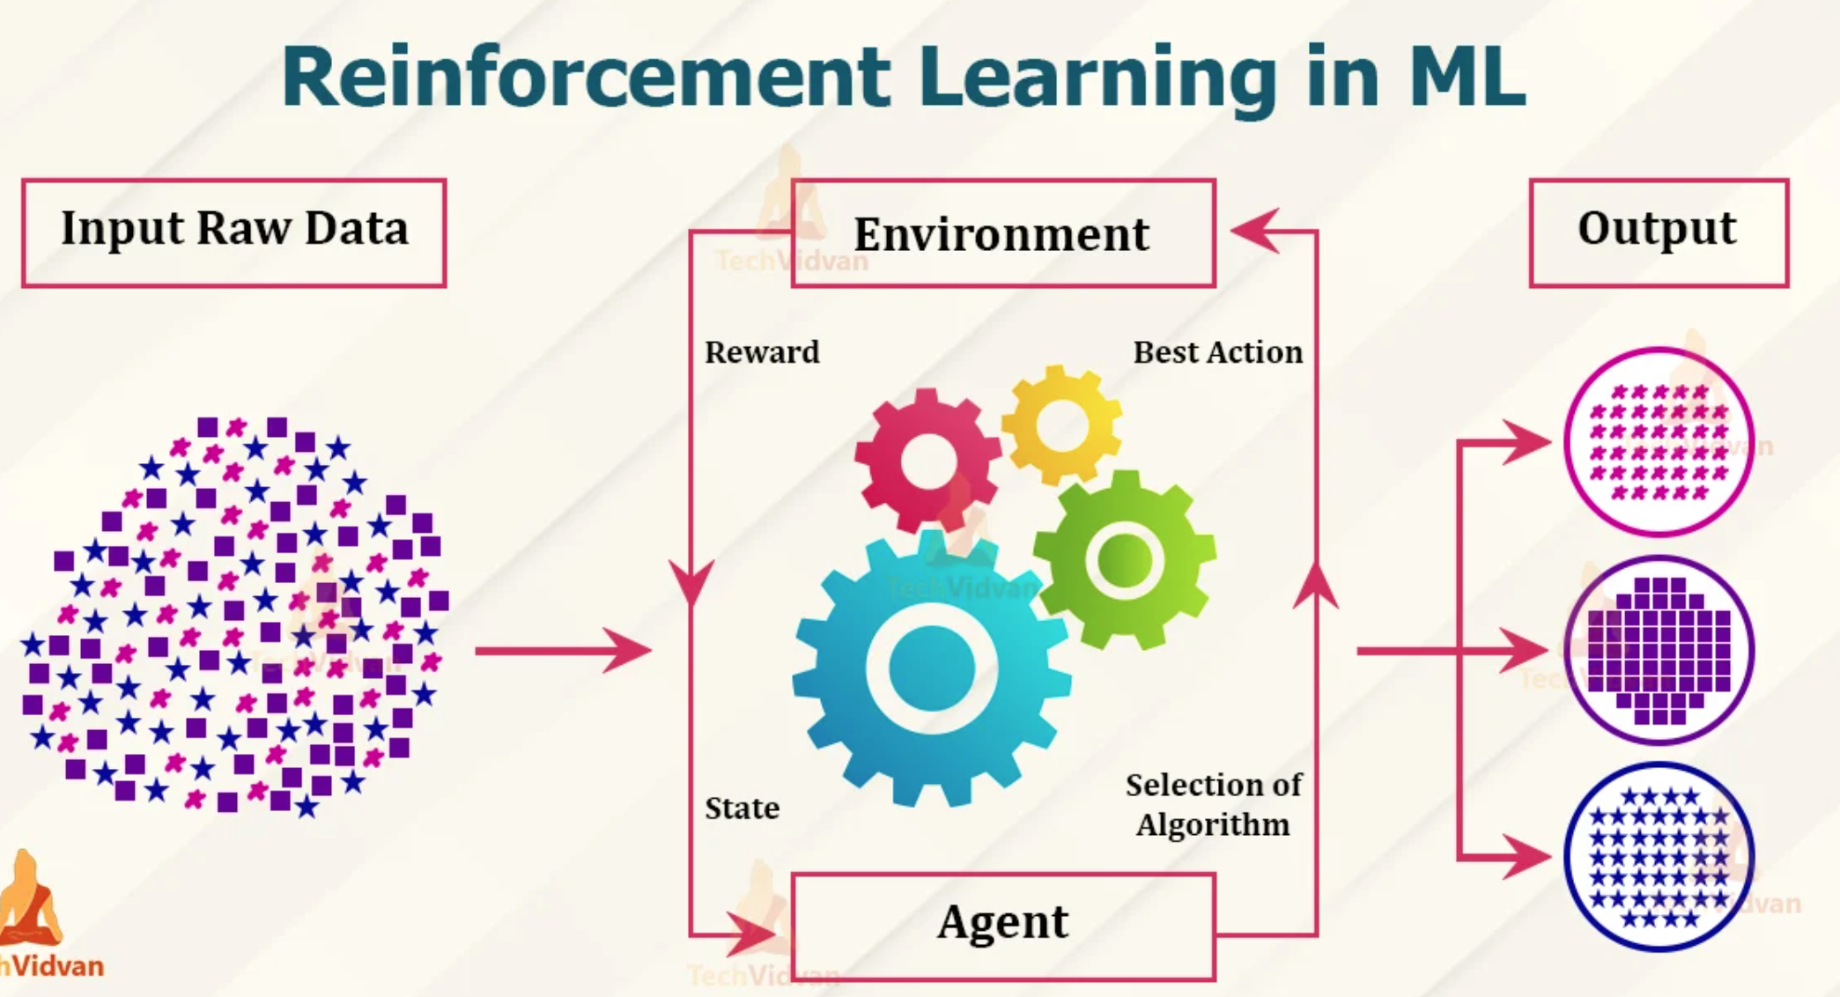

Slide 34
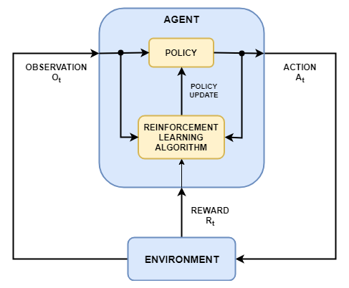
Reinforcement learning

Slide 35
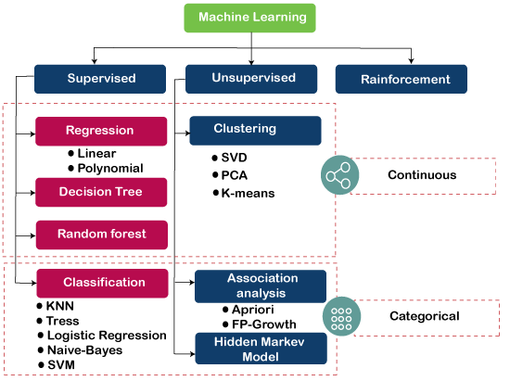

Slide 36
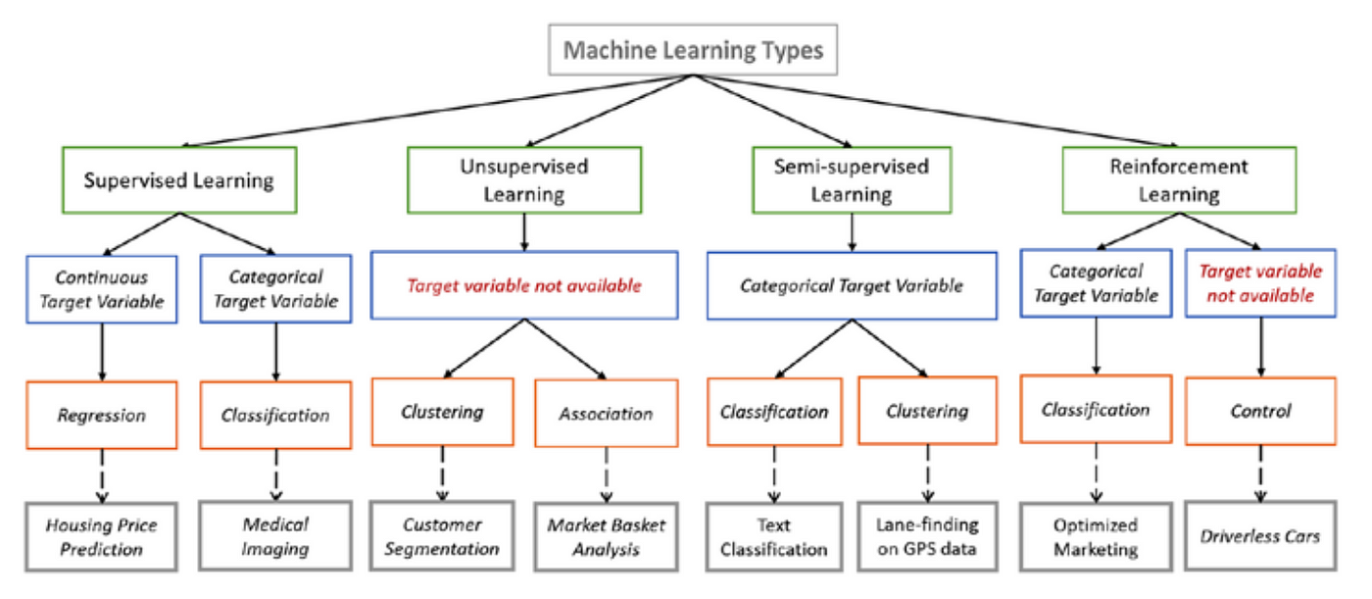

Slide 37
Supervised learning: Regression
Linear Regression
Simple Linear Regression
Multiple Linear Regression
Polynomial Regression
Support Vector Regression (SVR)
Decision Tree Regression
Random Forest Regression
GBT (XGBoost) Regression

Slide 38
Supervised learning: Classification
Logistic Regression
K-Nearest Neighbors
Support Vector Machine (SVM)
Kernel SVM
Naïve Bayes
Decision Tree Classification
Random Forest Classification
GBT (XGBoost) Classification

Slide 39
Unsupervised Learning
K-Means Clustering
Hierarchical Clustering
Principal Component Analysis (PCA)
Linear Discriminant Analysis (LDA)

